Slide 1
Storage and File Organization
Notes:
1

Slide 2
Data representation

Slide 3
Issues
How do we represent
Datatypes as fields
Fixed/variable tuples
Records into blocks
Relation as collection of blocks (file)
How do we handle Database modifications when record size changes

Slide 4
File Organization
The database is stored as a collection of files. Each file is a sequence of records. A record is a sequence of fields.
One approach:
assume record size is fixed
each file has records of one particular type only
different files are used for different relations

Slide 5
Representing DataTypes
Fixed length Character String: CHAR(n)
Using special ‘Pad’ Character
Variable length Character String: VARCHAR(n)
Using n+1 bytes
Two representations:
Length plus content
Null-terminated string
Dates and Times: DATE (10 byte representation)
Can be represented as fixed/variable character string
A sequence of Bits: BIT(n)
Enumerated Type : finite set of values

Slide 6
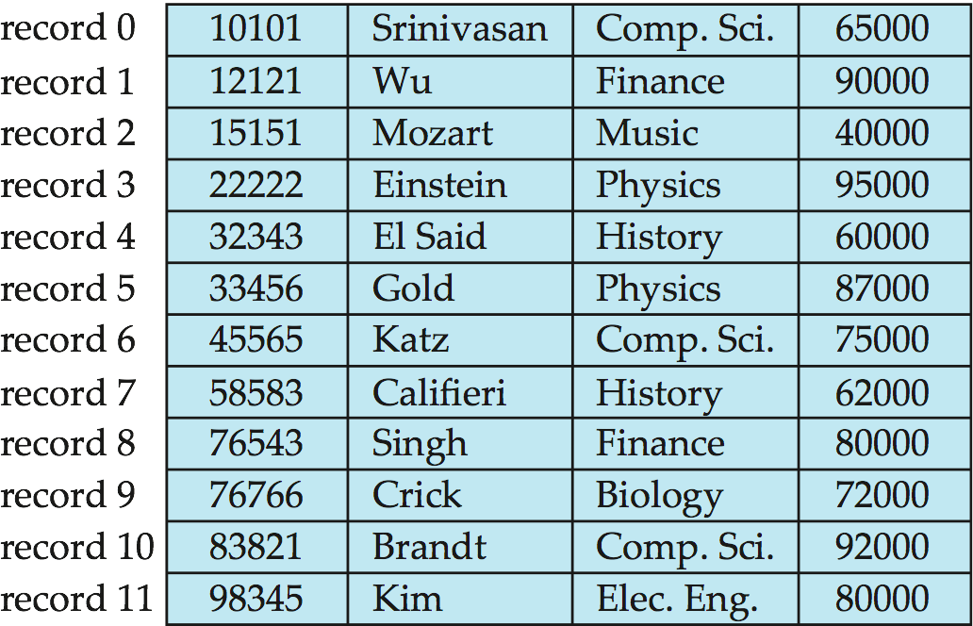
Fixed-Length Records
Simple approach:
Store record i starting from byte n ∗ (i – 1), where n is the size of each record.
Record access is simple but records may cross blocks
Modification: do not allow records to cross block boundaries
Deletion of record i: alternatives:
move records i + 1, . . ., n to i, . . . , n – 1
move record n to i
do not move records, but link all free records on a free list

Slide 7
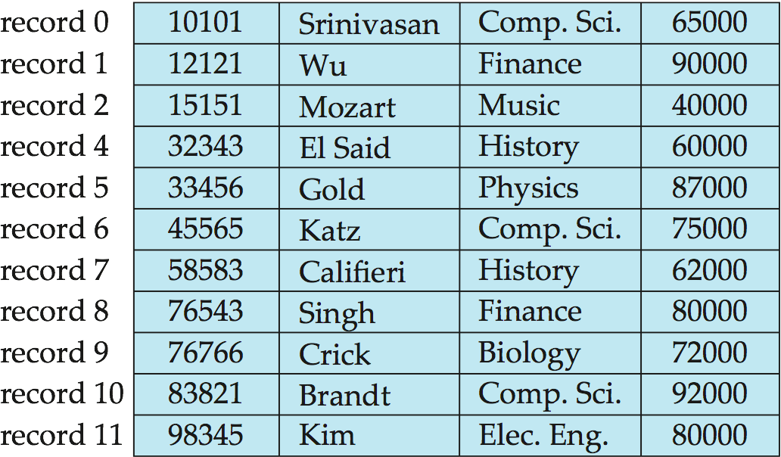
Deleting record 3 and compacting

Slide 8
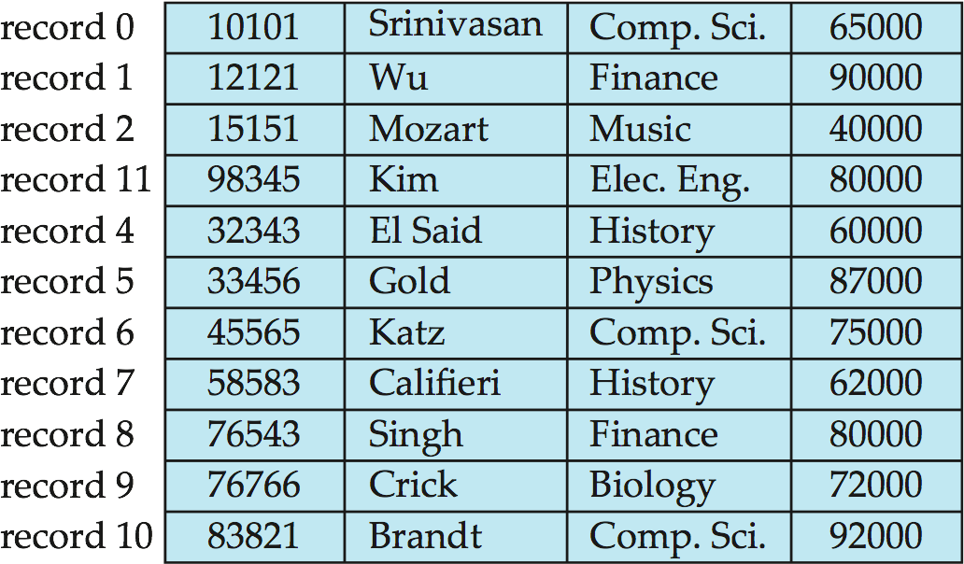
Deleting record 3 and moving last record

Slide 9
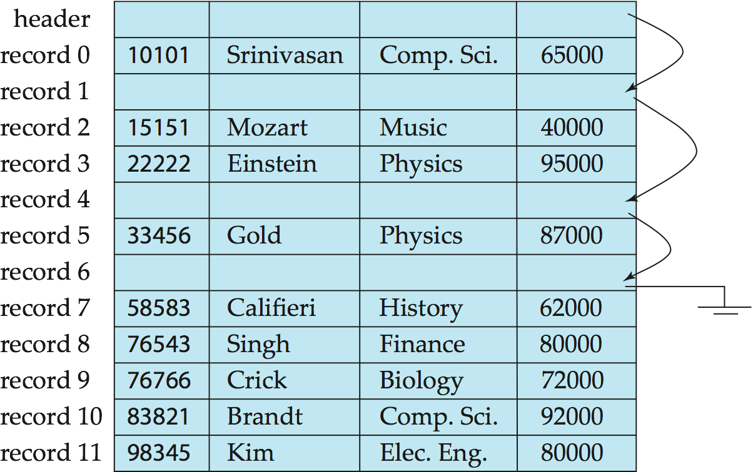
Free Lists
Store the address of the first deleted record in the file header.
Use this first record to store the address of the second deleted record, and so on
Can think of these stored addresses as pointers since they “point” to the location of a record.
More space efficient representation: reuse space for normal attributes of free records to store pointers. (No pointers stored in in-use records.)

Slide 10
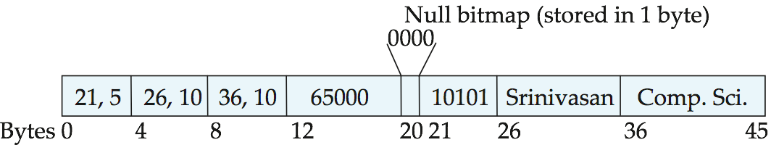
Variable-Length Records
Variable-length records arise in database systems in several ways:
Storage of multiple record types in a file.
Record types that allow variable lengths for one or more fields such as strings (varchar)
Record types that allow repeating fields (used in some older data models).
Attributes are stored in order
Variable length attributes represented by fixed size (offset, length), with actual data stored after all fixed length attributes
Null values represented by null-value bitmap

Slide 11
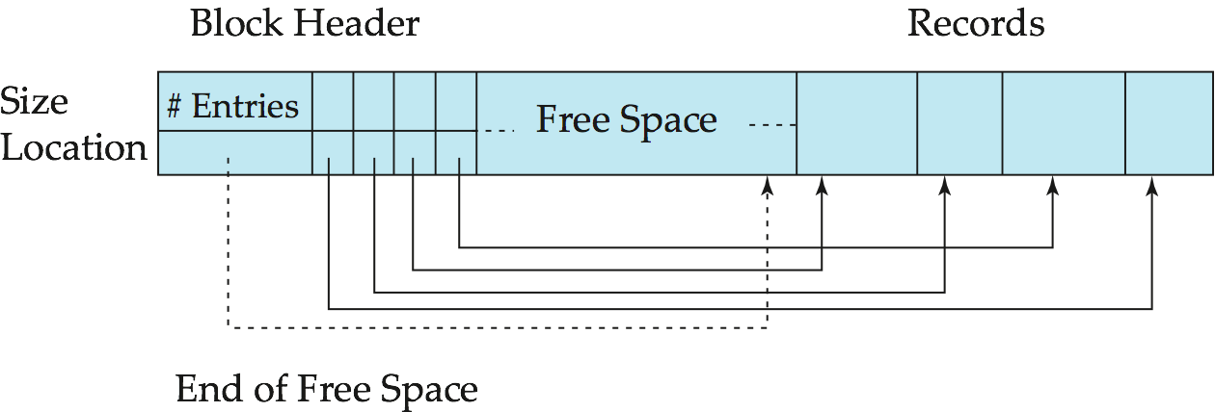
Variable-Length Records: Slotted Page Structure
Slotted page header contains:
number of record entries
end of free space in the block
location and size of each record
Records can be moved around within a page to keep them contiguous with no empty space between them; entry in the header must be updated.
Pointers should not point directly to record — instead they should point to the entry for the record in header.

Slide 12
Unordered Files
Also called a heap or a pile file.
New records are inserted at the end of the file.
A linear search through the file records is necessary to search for a record.
This requires reading and searching half the file blocks on the average, and is hence quite expensive.
Record insertion is quite efficient.
Reading the records in order of a particular field requires sorting the file records.

Slide 13
Ordered Files
Also called a sequential file.
File records are kept sorted by the values of an ordering field.
Insertion is expensive: records must be inserted in the correct order.
It is common to keep a separate unordered overflow (or transaction) file for new records to improve insertion efficiency; this is periodically merged with the main ordered file.
A binary search can be used to search for a record on its ordering field value.
This requires reading and searching log₂ of the file blocks on the average, an improvement over linear search.
Reading the records in order of the ordering field is quite efficient.

Slide 14
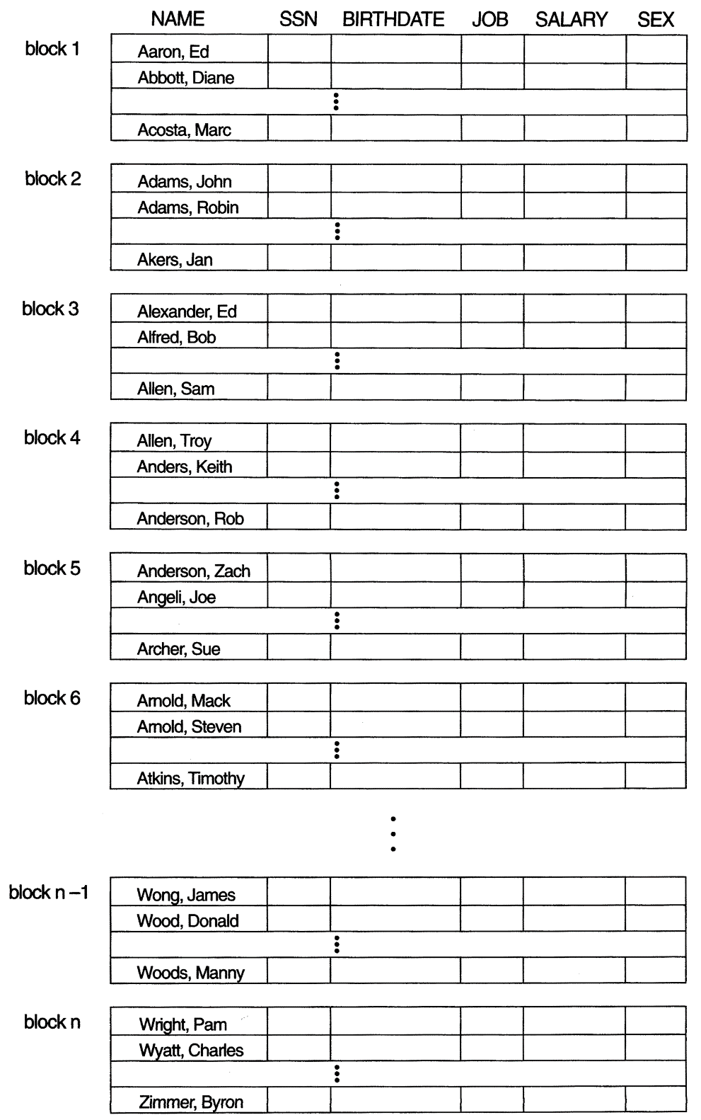
Ordered Files

Slide 15
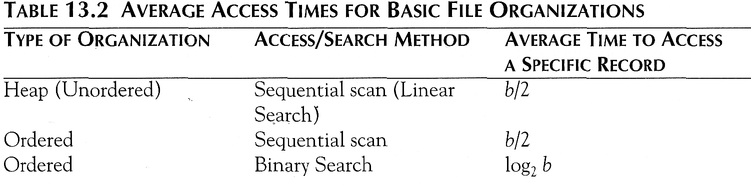
Average Access Times
The following table shows the average access time to access a specific record for a given type of file

Slide 16
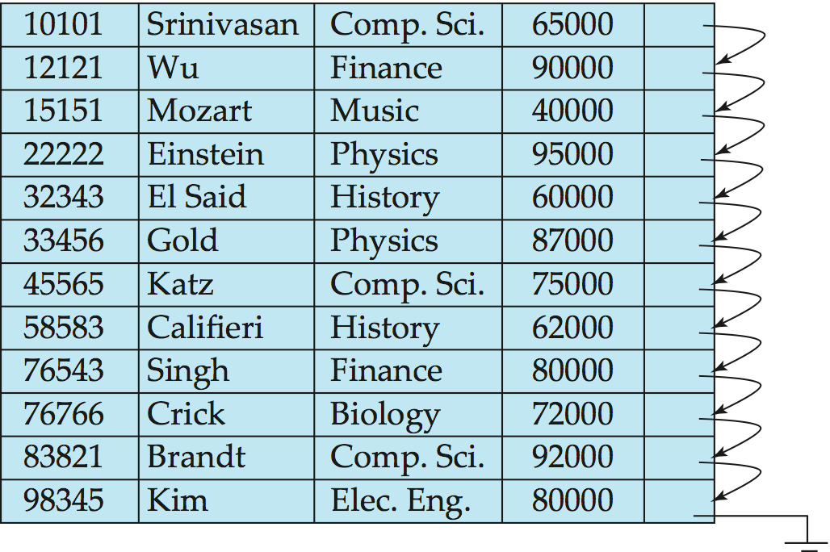
Sequential File Organization
Suitable for applications that require sequential processing of the entire file
The records in the file are ordered by a search-key

Slide 17
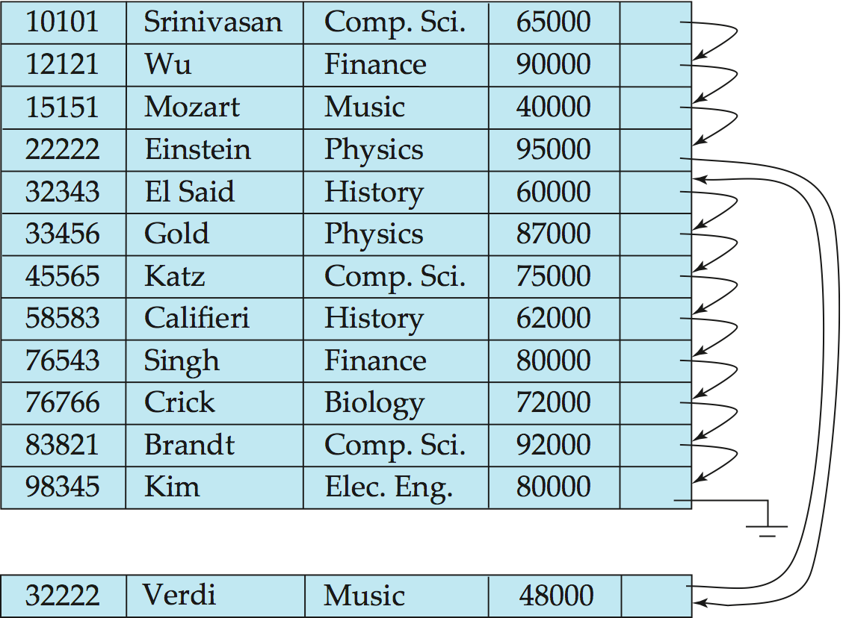
Sequential File Organization (Cont.)
Deletion – use pointer chains
Insertion –locate the position where the record is to be inserted
if there is free space insert there
if no free space, insert the record in an overflow block
In either case, pointer chain must be updated
Need to reorganize the file from time to time to restore sequential order

Slide 18
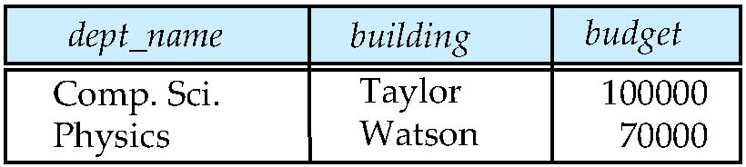
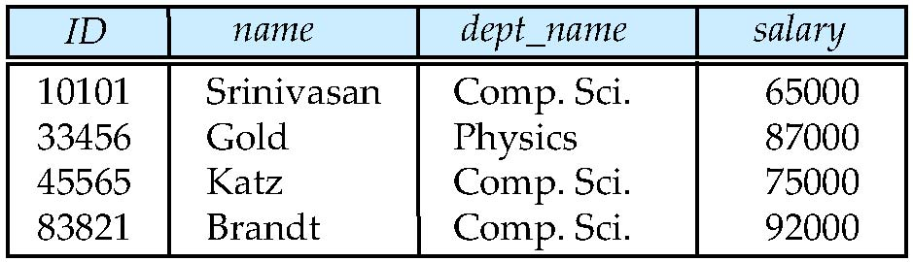
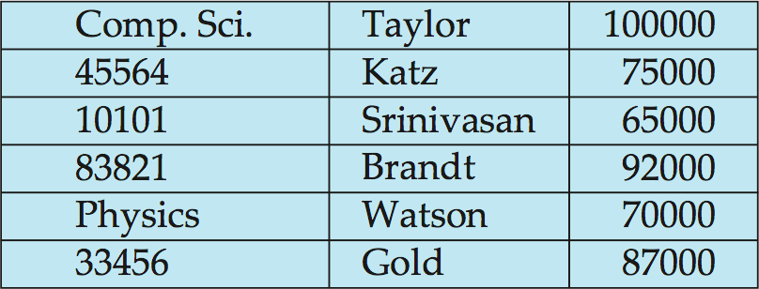
Multitable Clustering File Organization
Store several relations in one file using a multitable clustering file organization
department
instructor
multitable clustering
of department and
instructor

Slide 19
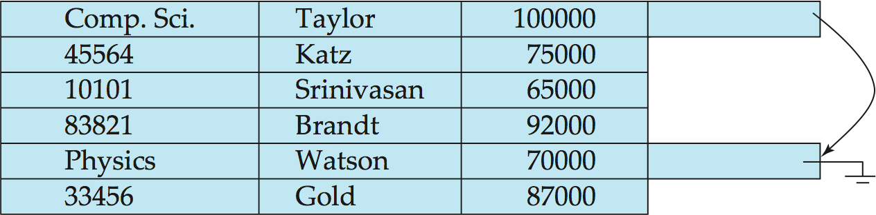
Multitable Clustering File Organization (cont.)
good for queries involving department instructor, and for queries involving one single department and its instructors
bad for queries involving only department
results in variable size records
Can add pointer chains to link records of a particular relation

Slide 20
Data Dictionary Storage
The Data dictionary (also called system catalog) stores metadata; that is, data about data, such as
Information about relations
names of relations
names, types and lengths of attributes of each relation
names and definitions of views
integrity constraints
User and accounting information, including passwords
Statistical and descriptive data
number of tuples in each relation
Physical file organization information
How relation is stored (sequential/hash/…)
Physical location of relation
Information about indices

Slide 21
File Organization and Index structures/files
Dense, Sparse, Primary, Secondary,
Clustered, Un-clustered files
I/O Cost based Analysis model
Notes:
1

Slide 22
Introduction
Issue
How to get required records efficiently
Example
SELECT * from R;
SELECT * from R where A=10;
Index is a data structure that lets us find quickly records with given ‘search key’ value without having to look at more than a fraction of all records
An index takes a value for search key and finds records with the matching value

Slide 23
An index file takes much less space than the corresponding data file
An index is especially advantageous if it can fit in memory
A record can be found with only one disk I/O
An index itself can be too large to fit in the memory
Multi-level indexes
Only part of index in memory

Slide 24
Types of index structures
Simple indexes on sorted files
Usually, created on primary key
Secondary indexes on unsorted files
Clustered indexes
B-trees, a commonly used structure
Hash table

Slide 25
Primary Indexes (On sorted files)
The simplest structure
The data file is a sequential file
The data file is sorted on a key, usually primary key
The index file consists of <key,pointer> pairs
Types of indexes
Dense: every record has an entry in the index
Sparse: only some of the data records have entries in the index

Slide 26
Dense indexes
Every key from the data file is represented
Entries are in the same order as that of the file
Binary search can be used to find the required <key, pointer>
No.of blocks searched ‘log n’ instead of n/2 on an average

Slide 27
Example: 1,000,000 tuples, 10 tuples/4096 byte block, key field 30 bytes, pointer 8 bytes
Data file takes 400MB space
Index file will take 10,000 blocks with100 entries/block
Search will involve at most log10000 = 13 blocks in MM
Memory can also be optimized by keeping only most searched blocks in memory
Hence a record can be retrieved with less than 14 disk I/Os

Slide 28
Sparse indexes
Useful if dense index is too large
Uses less space at the cost of possibly more time to search
Generally a record, usually the first, per block is represented
Sparse index for previous example would take only 1000 blocks, 4MB
But, it can not give quick answer to query ‘does there exist a record with key value K?”
It requires one disk I/O with searching in the block
Search K: find entry with largest key ≤ K

Slide 29
Multi-level indexes
When an index is too large with even binary search taking too many disk I/Os
Define second level index: index on index
This can continue to multi-level index structure
Second and higher level indexes must be sparse
Second level index in previous example would take only 10 blocks, 40KB
Search involves 2 disk I/Os and searching in the block

Slide 30
Secondary indexes
SELECT name, address
FROM MovieStar
WHERE birthdate=DATE ‘1952-01-01’
CREATE INDEX BDIndex ON MovieStar(birthdate);
Secondary index does not determine the location of the record
Secondary indexes are always ‘dense’
Second level index could be ‘sparse’
Secondary indexes are usually with duplicates

Slide 31
20
40
Secondary index
10
10
20
20
10
20
50
30
20
30
40
50
10
50
60
20

Slide 32
Pointers in one index block may refer to multiple data blocks
Results in more number of Disk I/Os
Unavoidable problem
Using ‘bucket file’ between index file and data file
Single entry <k,p> for each value ‘k’ where p points to location in bucket file containing all other pointers of records with value ‘k’
Avoids wastage of space due to multiple storage of same value ‘k’

Slide 33
20
40
10
20
30
40
10
20
50
30
50
60
10
50
60
20
Index file
Bucket file
Data file

Slide 34
Application of ‘bucket file’
It can help answer queries efficiently using intersection of pointer sets
Example
SELECT title
FROM Movie
WHERE StudioName=‘Disney’ AND year=1995;
This reduces number of Disk I/Os

Slide 35
Movie Tuples
Buckets for studio
Buckets for year
Disney
1995
Studio index
Year index

